Slide 1




“PulmonDB: a gene expression lung diseases database”
Ana Beatriz Villaseñor Altamirano
CMO-BIRS Oaxaca, Mexico
Notes:
Good morning everyone, the title of this presentation is PulmonDB: a gene expression lung disease database, I will be presenting you the idea of this compendium but.. I will also present a study case in which we used PulmonDB, the aim was to find the gene expression signature of COPD in lung tissue.

Slide 2
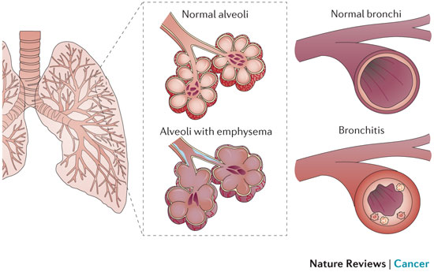






COPD: Chronic Obstructive Pulmonary Disease
COPD is a term used to describe emphysema and bronchitis combination and it is characterized by breathe incapacity (FEV1/FVC <0.7).
Emphysema
Bronchitis
Risk factors
Environmental factors
Genetic factors
A. McGarry Hougton, Nature Reviews 2013
AAT
Peter J. Barnes, Nature Reviews 2015
4th leading cause of
death
Notes:
1965 William Briscoe, fue la primera persona que usó el termino EPOC. No mencioné GOLD mas Adelante. O decir mas en perspectivas que quieres hacer analisis con los diferentes GOLD. La razon por la que digo aat es para justificar que no se conocen todos los factores geneticos y que este solo explica menos del 1 %
Los pacientes desarrolla cierto grado de enfisema y bronquitis.
Insuficiencia
Cadmium dust. Cadmium fumes. Grain and flour dust
Cadmium dust
Cadmium fumes
Grain and flour dust
Mineral dust
Organic dusts
Silica dust
Welding fumes

Slide 3




Strategy
Compendium
Raw data
Sample curation
Gene expression lung diseases database

Slide 4


Search in GEO and ArrayExpress
Data filtration
Data download in COMMAND
Data selection
- COPD related experiments
- Raw data
- Probes available
K. Engelen, Plos One, 2011
2011
2015
Escherichia coli K-12
Vitis spp
fur
VvibZIPC22
Notes:
one of the candidate genes specifically associated to flavonol biosynthesis, which is being proposed as a new regulator of flavonoid biosynthesis in grapevine.
Búsqueda, GEO, redactar sanos y EPOC en el filtrado. Poner los puntos de COMMAND.
Cuando hable de curacion, poner las variables que se estan curando (solo las mas representativas)
Hacer una linea de tiempo de cuanto me tardé en hacer las cosas
aparecer despues ecoli
no decir TF
Pensar en si quiero hacer esto

Slide 5
Classical analysis: contrast per group
Controls
Patients
Low expression
High expression
Underexpressed
Overexpressed
Platform variation
No expresión differencial
✽
✽
✽
Differencial expression
✽
✽
Contrast
=
=
Patient
log(
)
Control
Control vs Patient
Notes:
alternative

Slide 6
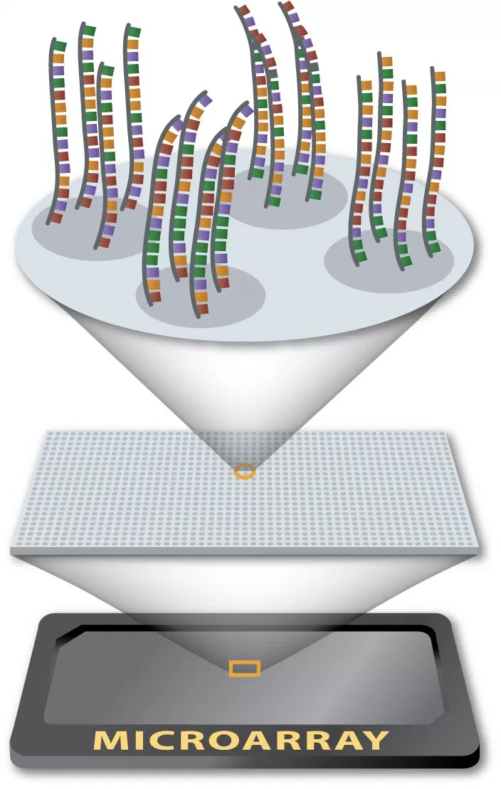
Contrast per sample
Each experiment is treated separately
Affymetrix
✽
✽
✽
✽
✽
✽
✽
✽
Ref
Test
Test
Test
Control vs Control
Control vs Patient
Ref vs Test
Ref vs Test
Ref vs Test
Notes:
Cambiar los nombres
Ref-Control, control, paciente, paciente
Transparencia

Slide 7
COMMAND steps to build the database
COMMAND
Data parsing
Contrast specification
Data homogenized
COPD vs Control
Control vs Control
Sample type
Clinical data
Don't use background correction
Log2
Loess or Quantil normalization
Gene sumarization (i.e. median polish)
MySQL data importation
Choose reference samples
Condition annotation
Re anotation
Microarrays probes
Blast of probes using Hg37 reference genome
Notes:
one of the candidate genes specifically associated to flavonol biosynthesis, which is being proposed as a new regulator of flavonoid biosynthesis in grapevine
Hacer una diapo de la curación de los datos

Slide 8
Gene expression lung diseases database
COPD
 | Homo sapiens
Experiments | 46 (25)
Samples | 3208 (~1674)
Genes | 19,687
IPF
Experimentos
25
Experiments | 27 (15)
Samples | 1112 (~600)
ASTHMA
CANCER
Notes:
RNAseq.
Añadir cuantos de sanos, cuantos pacientes,
Tipo de muestra
Heatmap para estado del habito de fumar?
;osaic plots
enfisema
grafica cnon COPD
Hacer mas enfasis en del caso de estudio
Conclusion con summary de todos los datos y concluir que ya tengo un resultado la base de datos

Slide 9
Gene expression lung diseases database
Notes:
RNAseq.
Añadir cuantos de sanos, cuantos pacientes,
Tipo de muestra
Heatmap para estado del habito de fumar?
;osaic plots
enfisema
grafica cnon COPD
Hacer mas enfasis en del caso de estudio
Conclusion con summary de todos los datos y concluir que ya tengo un resultado la base de datos

Slide 10
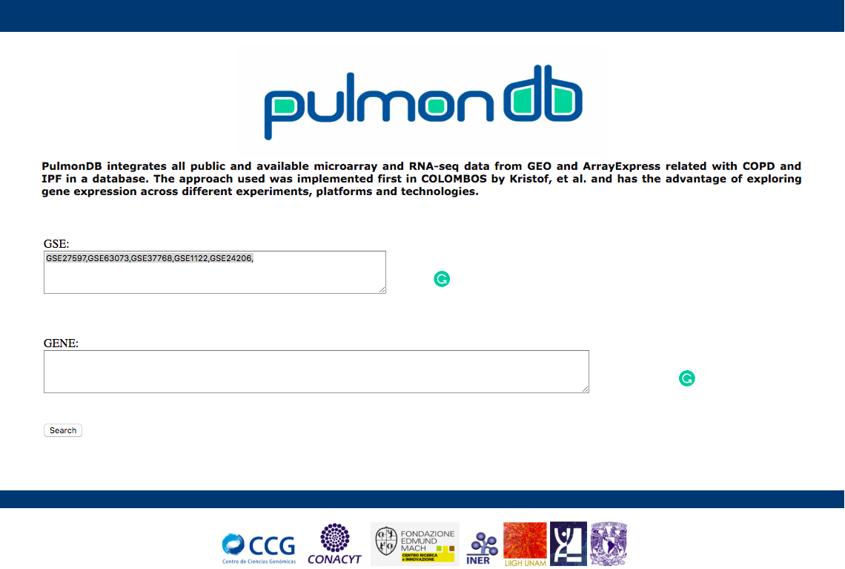
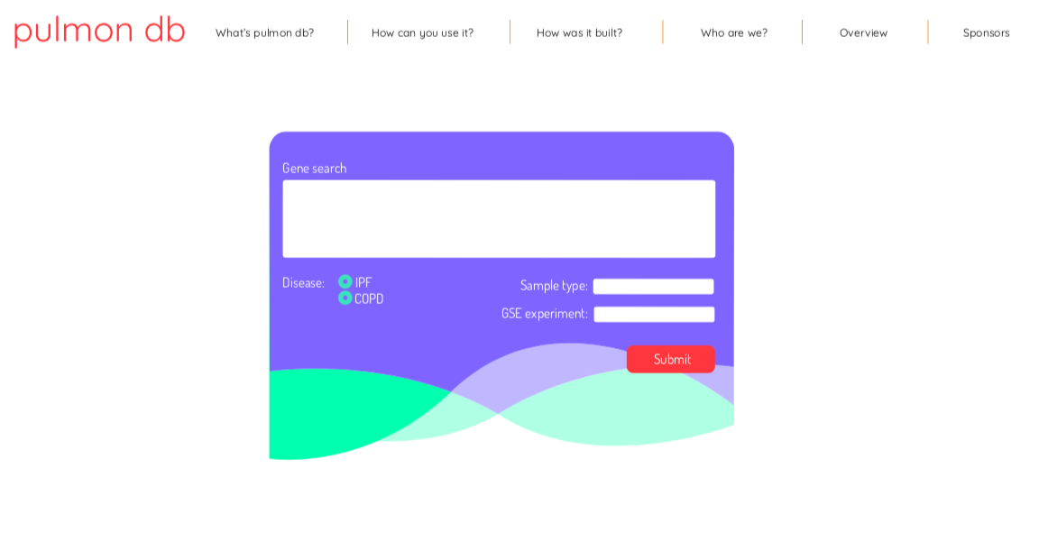
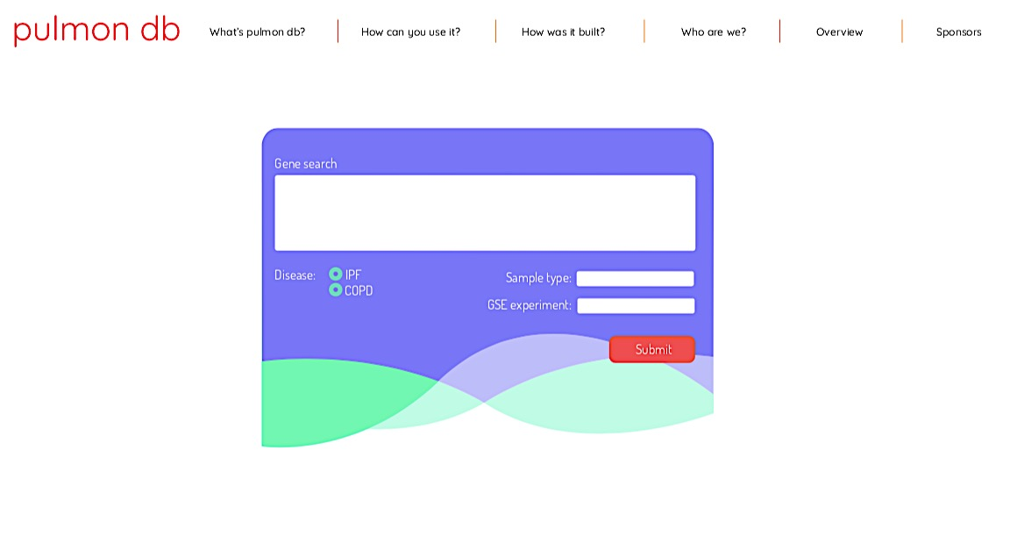
Web interfase
Notes:
ponerla al final del analisis
R2 cuanto expñican de mi varainz

Slide 11
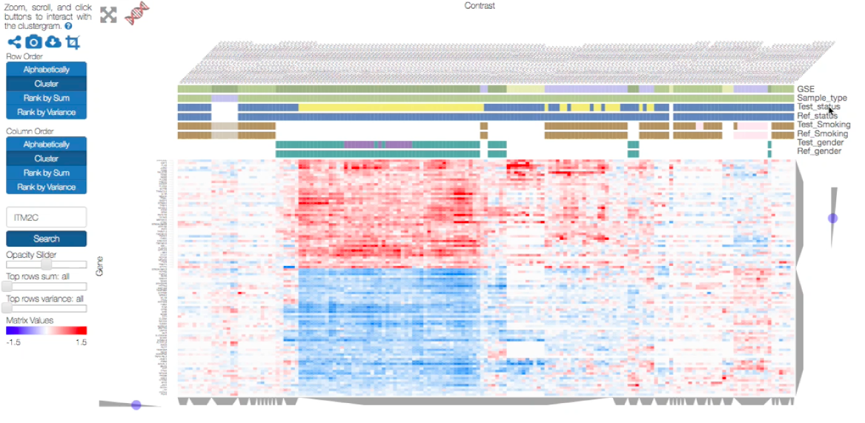
Interactive heatmap using clustergrammer library
clustergrammer

Slide 12
Interactive heatmap using clustergrammer library
clustergrammer

Slide 13
Interactive heatmap using clustergrammer library
clustergrammer

Slide 14
Interactive heatmap using clustergrammer library
clustergrammer

Slide 15
Interactive heatmap using clustergrammer library
clustergrammer

Slide 16
Interactive heatmap using clustergrammer library
clustergrammer

Slide 17
Interactive heatmap using clustergrammer library
clustergrammer

Slide 18
Interactive heatmap using clustergrammer library
clustergrammer

Slide 19
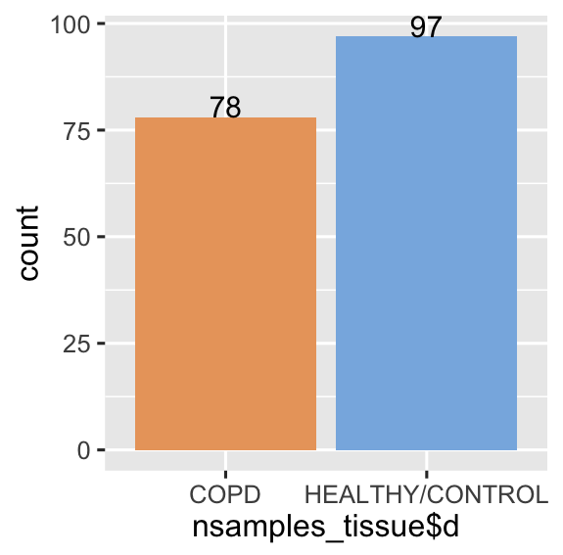
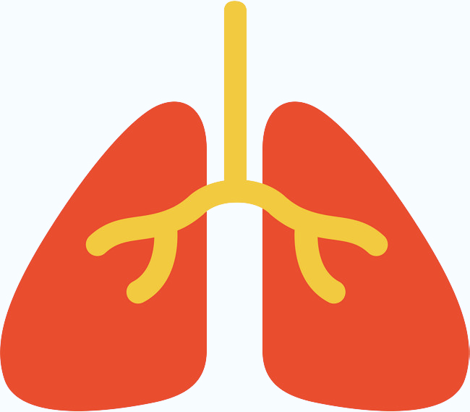
Exploratory case: analysis of lung tissue using individual contras from PulmonDB
Total: 175
Remove variable genes among the control group
✽
=
Cantidad de muestras
✗
✗
✽
✽
Ref
COPD/HEALTHY
HEALTHY/HEALTHY
Notes:
GSE37768
GSE29133
GSE27597
GSE1122
“contraaste
COPD: EPOC

Slide 20
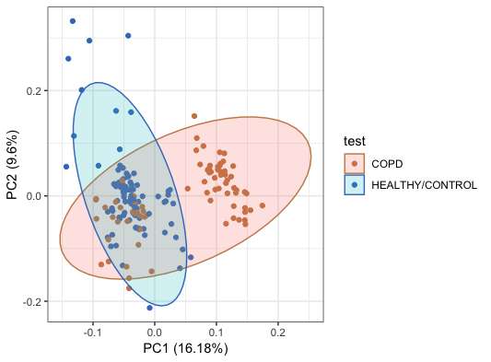
Small variation in the PC1 and PC2 may be explained by disease statues
COPD/ HEALTHY
HEALTHY/HEALTHY
Notes:
Dividir las muestras y validar el PCA con la otra mitad
princomp
COPD
Correlacion y no causalidad
quitar circulos

Slide 21
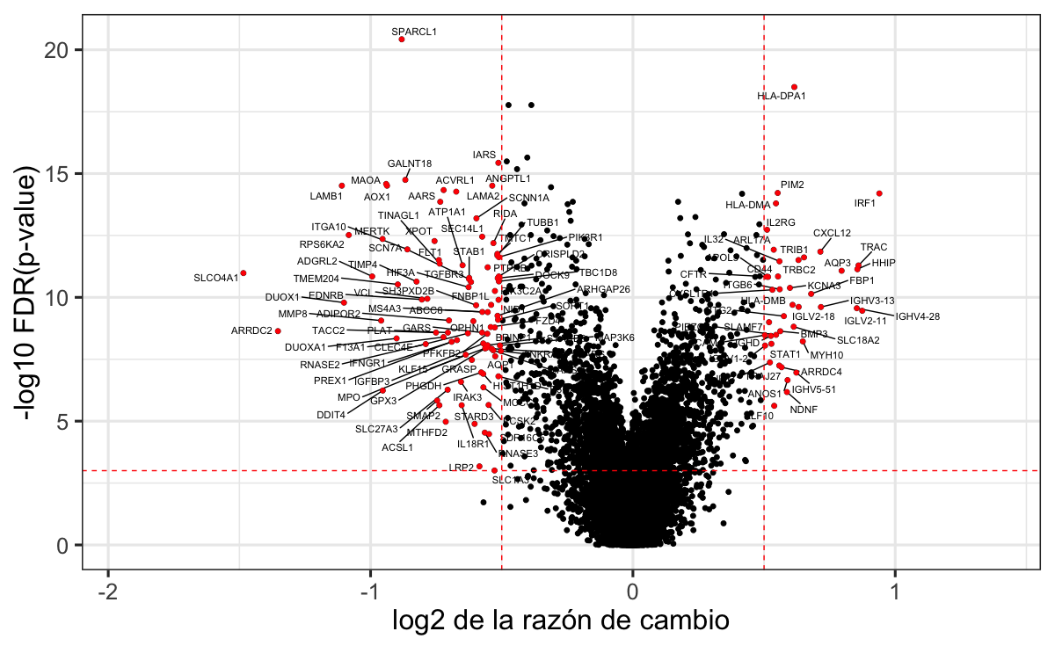

Differentially expressed genes among COPD patients and healthy individuals using t-test
HEALTHY/HEALTHY
COPD/ HEALTHY
Log2 (Fold change)

Slide 22
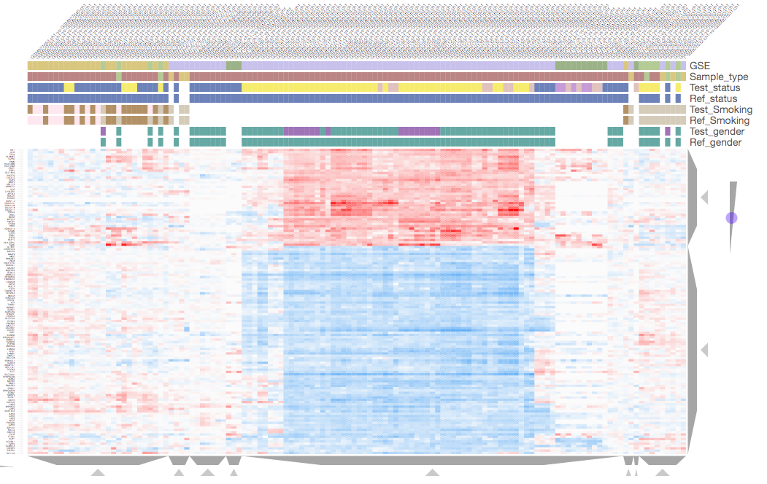
Signature of 132 genes using individual contrasts group COPD patients
clustergrammer

Slide 23

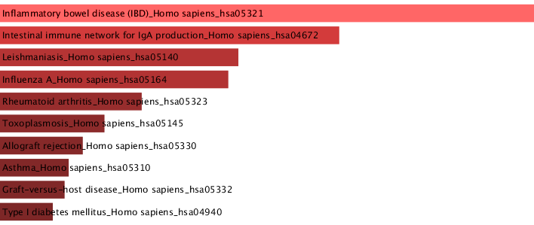
Up regulated genes in KEGG pathways are immune related
Inflammatory bowel disease (IBD)_Homo sapiens_hsa05321
Intestinal immune network for IgA production_Homo sapiens_hsa04672
Leishmaniasis_Homo sapiens_hsa05140
Influenza A_Homo sapiens_hsa05164
Rheumatoid arthritis_Homo sapiens_hsa05323
Toxoplasmosis_Homo sapiens_hsa05145
Allograft rejection_Homo sapiens_hsa05330
Asthma_Homo sapiens_hsa05310
Graft-versus-host disease_Homo sapiens_hsa05332
Type I diabetes mellitus_Homo sapiens_hsa04940

Slide 24

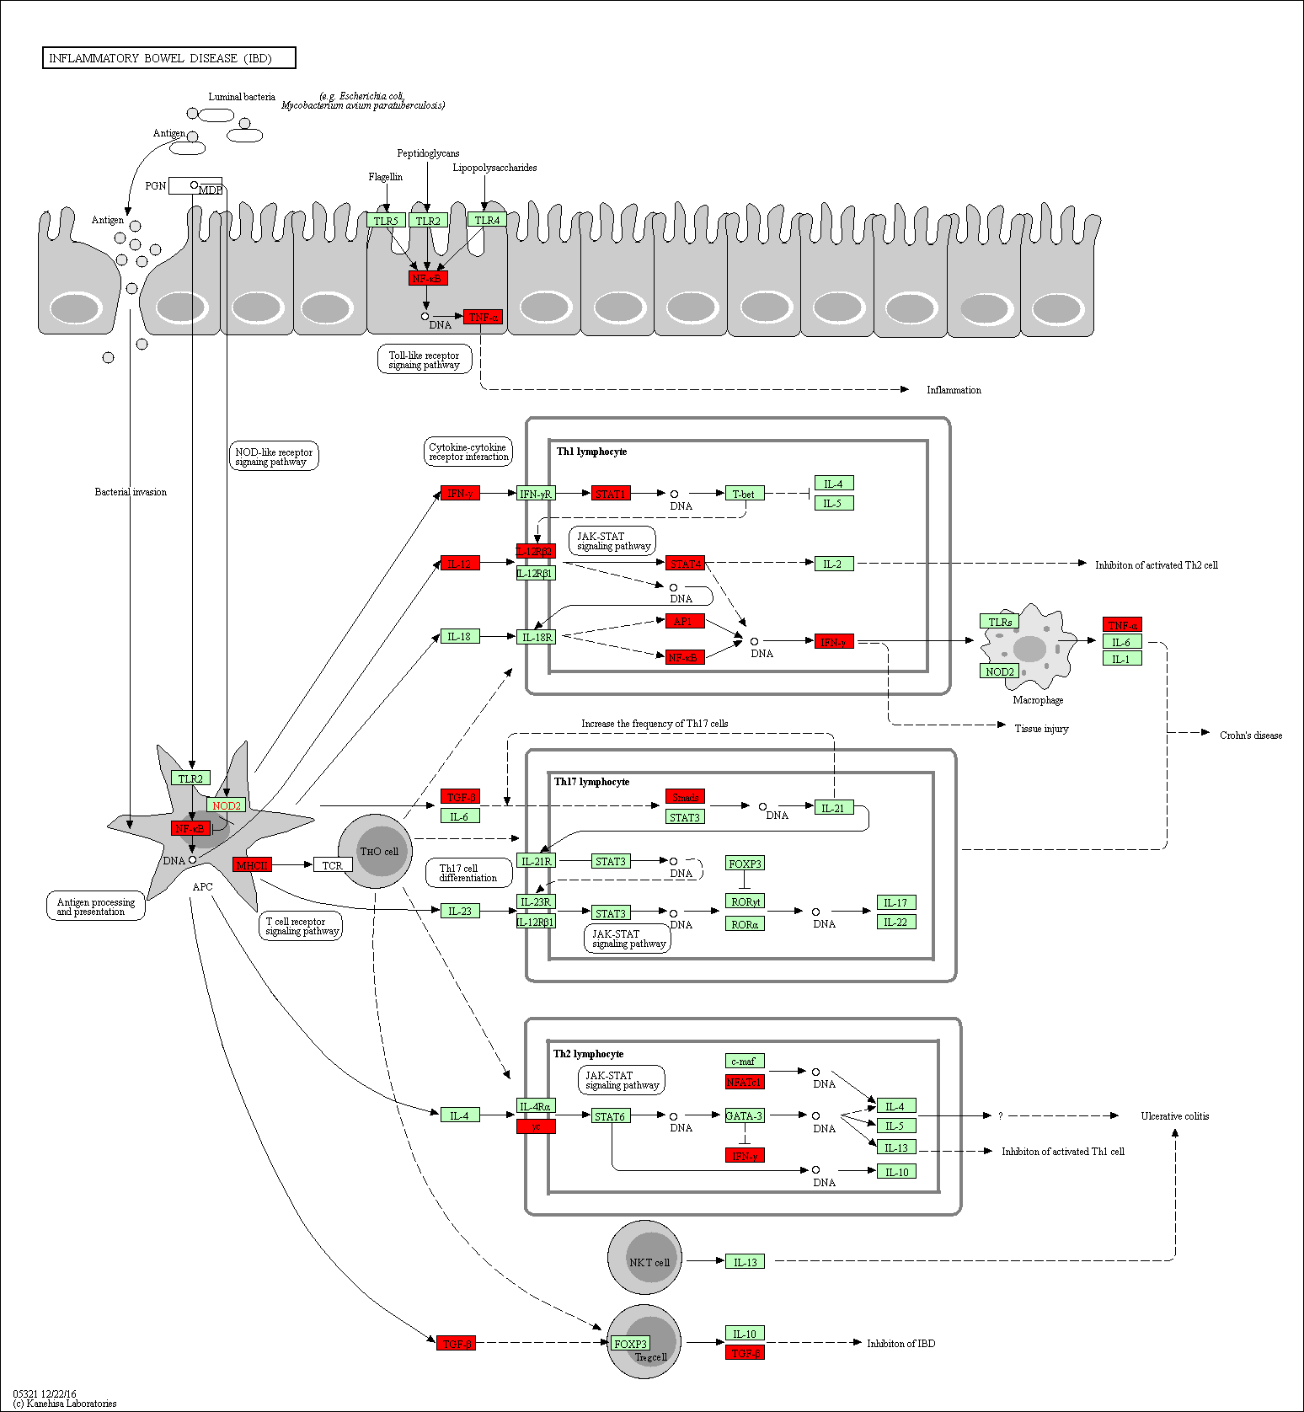
Inflammatory bowel disease (IBD)

Slide 25
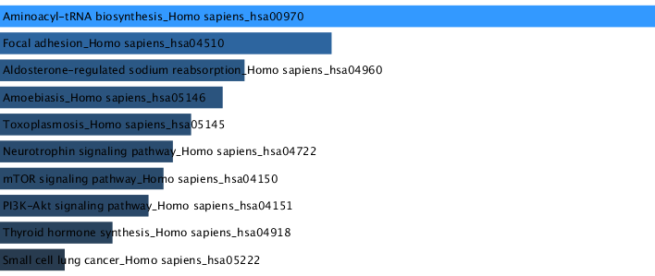
Down regulated genes in KEGG pathways are related with biosynthesis
Aminoacyl-tRNA biosynthesis_Homo sapiens_hsa00970
Focal adhesion_Homo sapiens_hsa04510
Aldosterone-regulated sodium reabsorption_Homo sapiens_hsa04960
Amoebiasis_Homo sapiens_hsa05146
Toxoplasmosis_Homo sapiens_hsa05145
Neurotrophin signaling pathway_Homo sapiens_hsa04722
mTOR signaling pathway_Homo sapiens_hsa04150
PI3K-Akt signaling pathway_Homo sapiens_hsa04151
Thyroid hormone synthesis_Homo sapiens_hsa04918
Small cell lung cancer_Homo sapiens_hsa05222

Slide 26
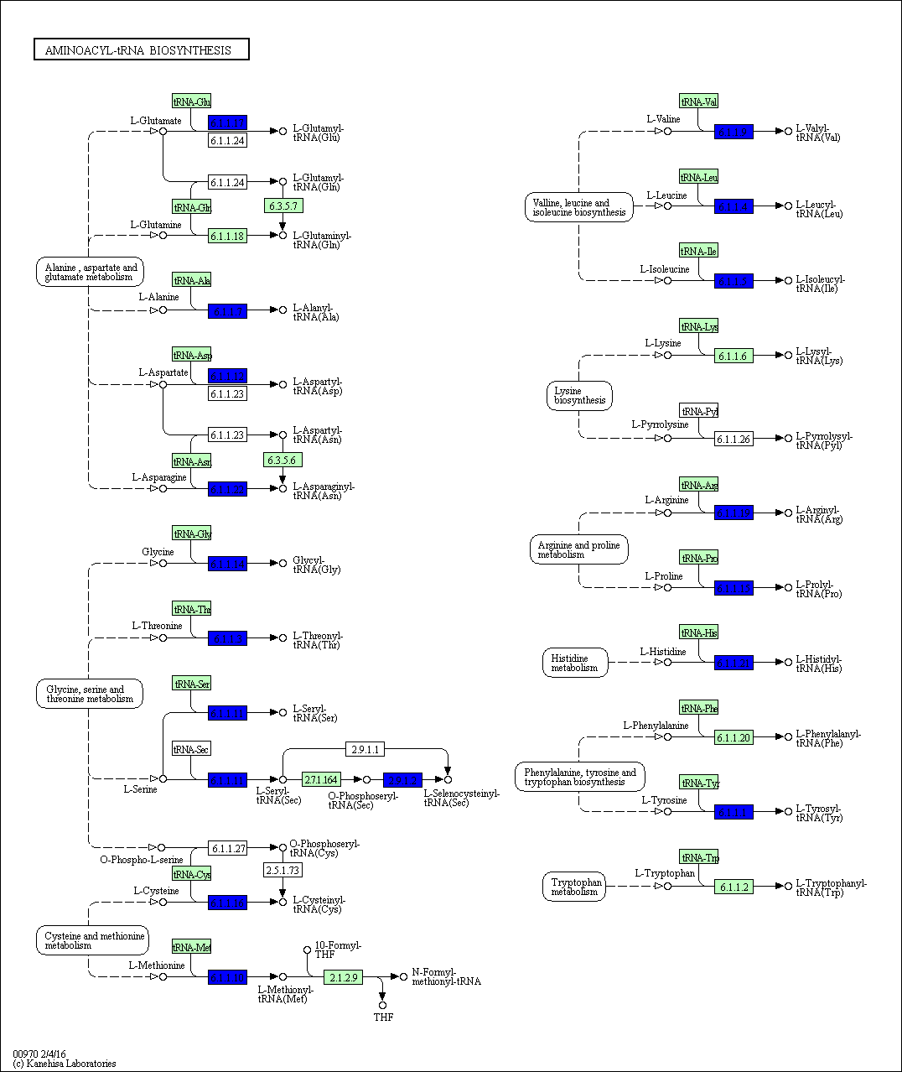
Aminoacyl-tRNA biosythesis

Slide 27
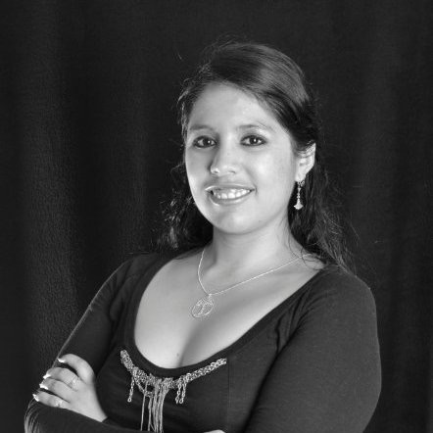




Aknowledgements
Profesors:
RegGenoLab:
Fronteras group:
Bioinformáticos:
Alejandra Zayas
Orlando Santillán
Curadores:
Mariel Maldonado
Adrián Medina
Julio Collado
Alejandra Medina
FEM:
Marco Moretto
Kristof Engelen
Marisol Álvarez
Lucía Morales
Karen Núñez
Walter Santana
Mónica Padilla
Aldo Hernández
Aníbal Rivera
Moisés Selman
Yalbi Balderas
IT
Luis A. Aguilar
Jair García
Annie Pardo
Notes:
conacyt
Una linea clara, poner los objetivos
con los objetivos.
Que aprendi de esto, que queda de hacer (66 genes)

